Slide 1
GEOG0113: Geography in the field
Introduction to Statistics
HOW TO USE RSTUDIO REMOTELY?
Dr Anwar Musah (a.musah@ucl.ac.uk)
Lecturer in Social and Geographic Data Science
UCL Geography
1

Slide 2
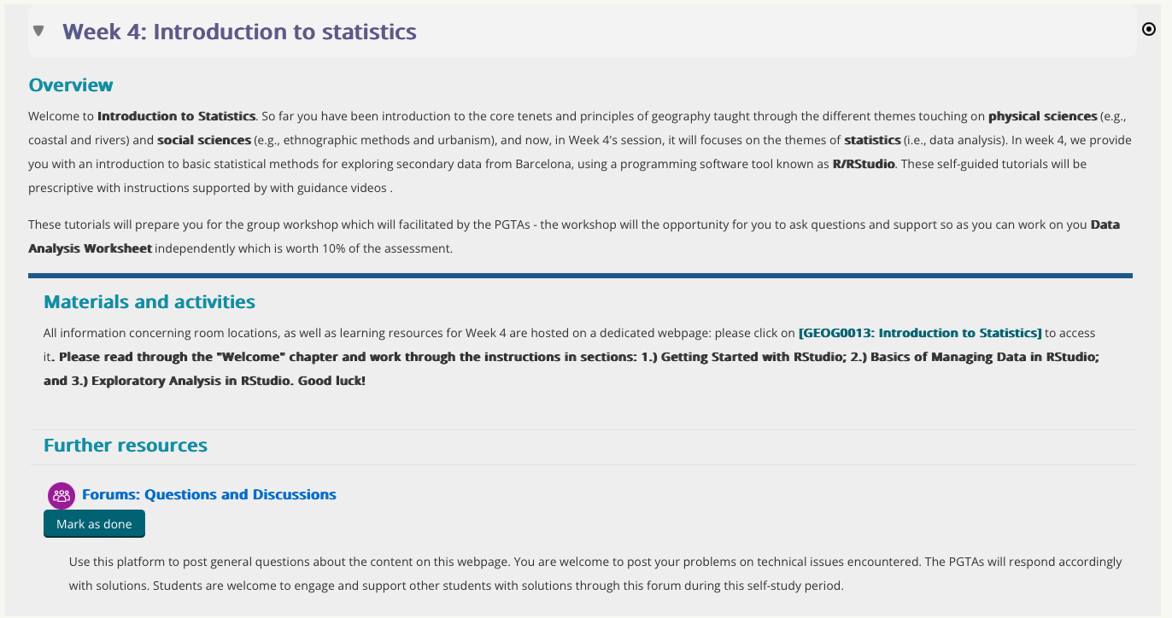
How access the self-study materials?

Slide 3
What is RStudio?
3
Notes:
But before we start, let’s do a quick recap on stuff we learnt last

Slide 4
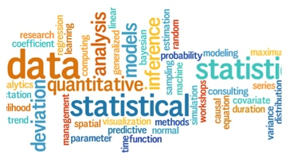
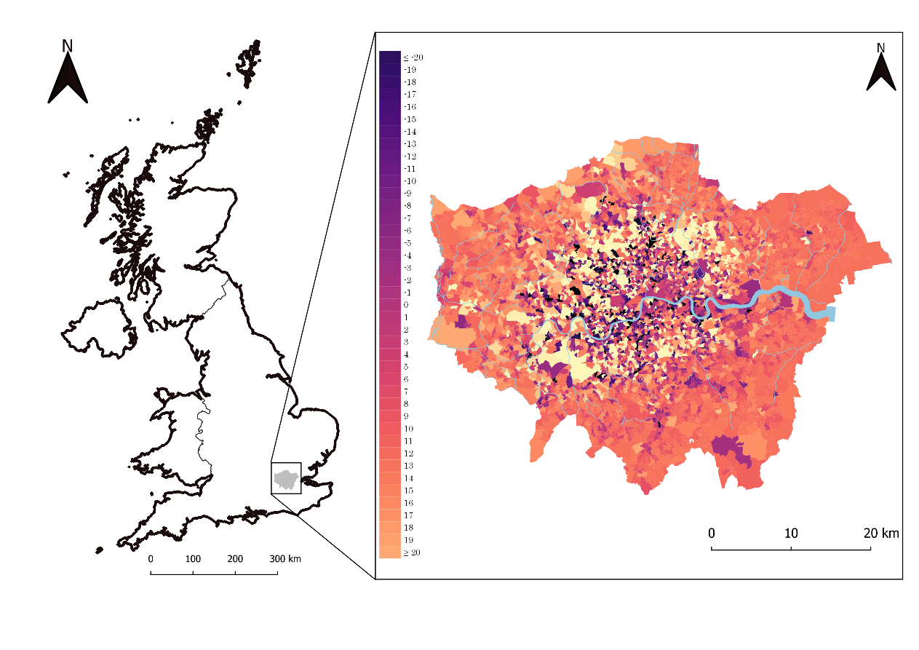


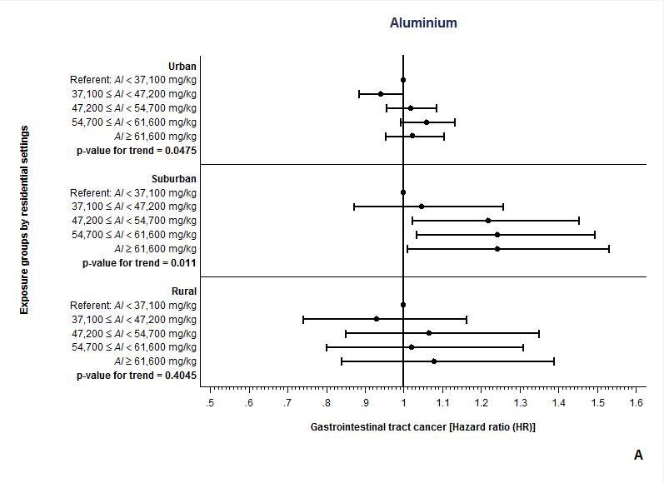

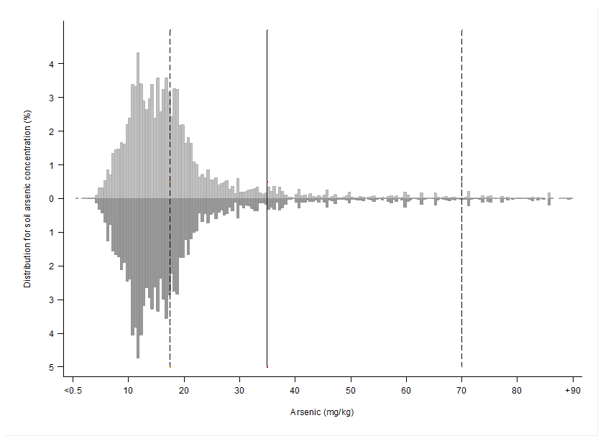
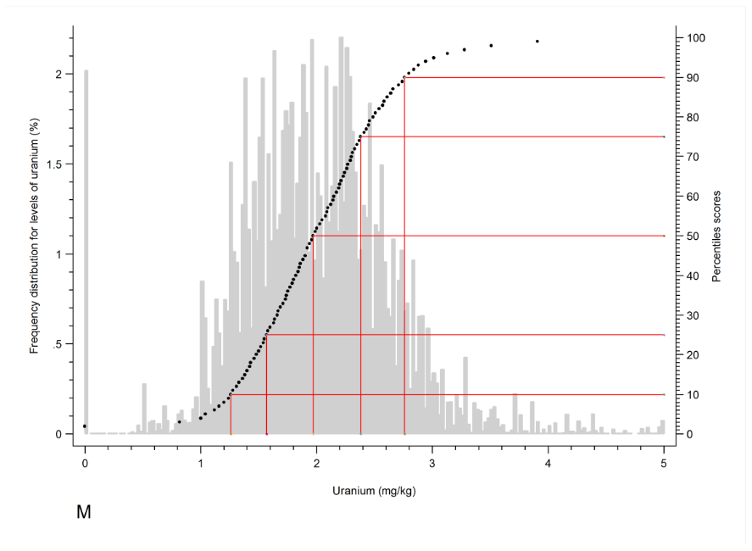
What is RStudio?
4
Notes:
R, or RStudio is a statistical software programming package that allows the user to carry out different types of statistical analysis. It can also be used as a GIS software to perform various kinds of analysis on geographical data. In the same vein, you can use it for data managing and geo-processing (i.e., importing different types of data that non-spatial, or spatial formats for manipulation beforehand for analysis).

Slide 5
R (Standard)
RStudio (Best)
There are two version of the software: 1.) R, and 2.) RStudio; The second is much preferred as its straightforward and intuitive.
5

Slide 6
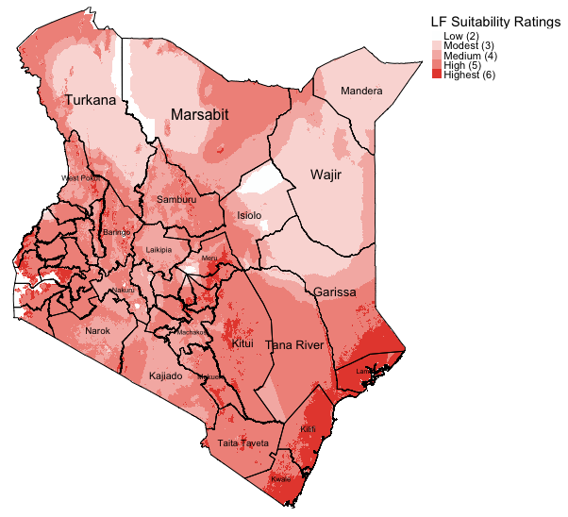


Why are we teaching RStudio?
Flexible and provides access to powerful packages for analysis
Impressive graphs, visualizations and maps
Excellent statistical capabilities too
Example: Map generated in R to illustrate areas that are environmentally suitable for the spread of neglected tropical disease called ‘Lymphatic Filariasis (LF)’ in Kenya.
Sources:
1. Global Atlas for Helminths Infection (http://www.thiswormyworld.org)
2. ESPEN (https://espen.afro.who.int)
6

Slide 7
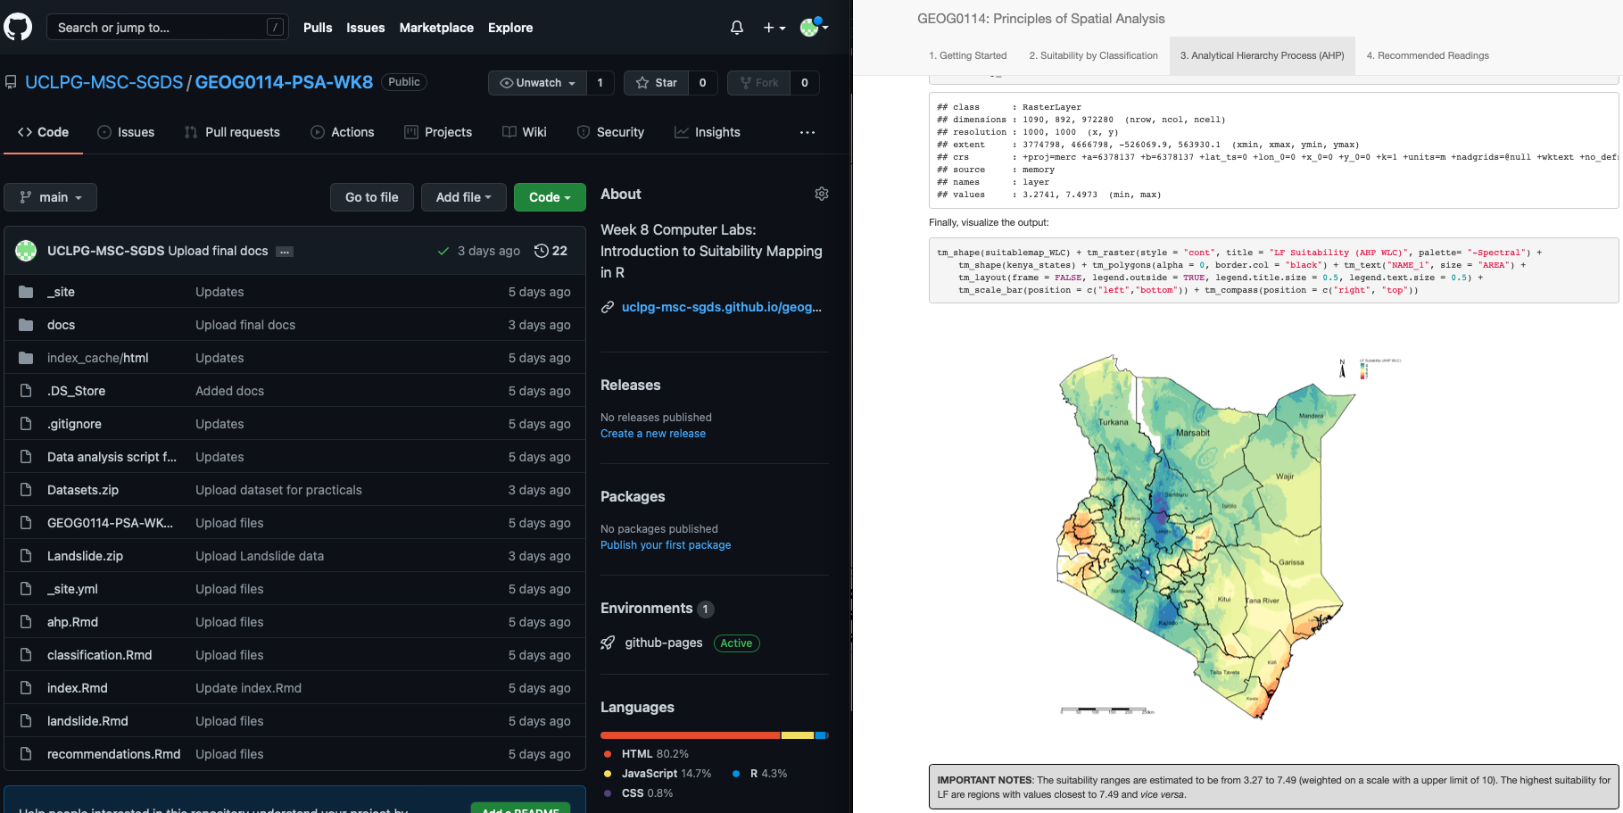
… and why learn how to code in RStudio?
Efficiency
Automated tasks and data managing
Can recycle & reuse code scripts for new projects
2. Fosters good scientific practice
Transparency and replication (AKA reproducible research)
Creates log so anyone can follow in your footstep (i.e., github, gitlab etc.,)
You can literally pull-off some really creative stuff like generating websites, accessing tools via APIs etc.
Example: Working in RStudio and synchronising it with GitHub to not only use as a cloud back-up, but to generate a website through RStudio and GitHub for teaching MSc Students.
Sources:
GitHub (https://github.com)
7

